Slide 1

Final Project
Churn Modelling at Bank JOGA

Slide 2






Our Dream Team
CHAERUL ANWAR
(CAKA)
VERMONA LUMBAN GAOL
ABDUL HAFIZ
FRANS RIANTONI
INDAH FAUZIYAH
Mentor: ADAM ARDIANSYAH

Slide 3
Agenda
Project Background
Preliminary Insight
Classification Model
Business Recommendation
s[eight]mantik Group

Slide 4
Project Background

Slide 5



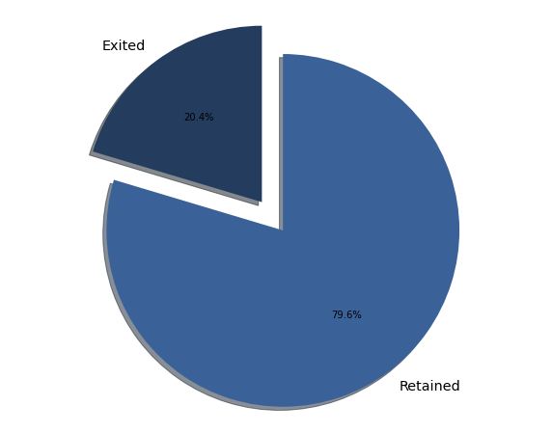
Problem Statement
Bank JOGA has a Churn rate of 20.37%. They loss 2.037 customers which impact to profit loss $ 185M.
20.37%

Slide 6
Problem Statement
Goals:
Decrease Churn Rate in Bank JOGA
Objectives:
Make a prediction of Bank JOGA’s customer probability to churn.
Provide recommendations for developing bank service strategies to increase bank customer loyalty
Business Metrics:
Churn Rate
Profit

Slide 7
Preliminary Insight

Slide 8


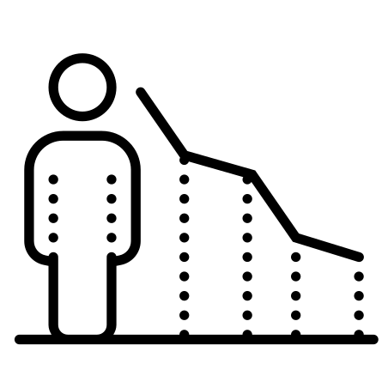
Dataset
There are 10.000 rows customer’s information that consists of customer profile and transaction.
Features
Features
Target
Customer’s Profile
CustomerId
Surname
Geography
Gender
Age
EstimatedSalary
Customer’s Transaction
Balance
Tenure
NumOfProducts
HasCreditCard
CreditScore
IsActiveMember
Churn
Not Churn

Slide 9

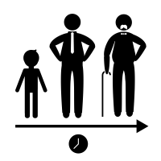



User Profile
Gender
Country
Female : 55%
Male : 45%
France : 50%
Germany : 25%
Spain : 25%
Age
Millennials : 60%
Gen Z : 4%
Gen X : 25%
Boomers II : 5%
Boomers I : 6%
Balance
Tenure
Bronze : 36%
Silver : 14%
Gold : 25%
Platinum : 25%
Short_term : 51%
Medium_term : 45%
Low_term : 4%

Slide 10
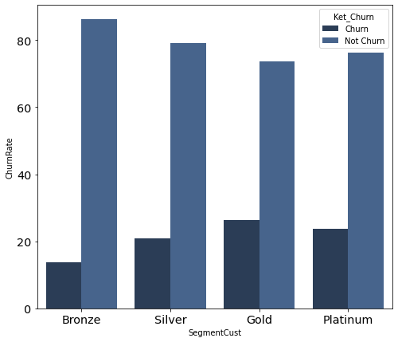




Churn Insight by Customer’s Balance Category
0 $
0 $ - 97.198$
97.198$ - 127.644$
>127.644$
26%
21%
24%
14%
The number of customers who have Balanced in ‘Gold’ Category is more likely to leave the Bank Service. They have a good balance that gives a contribution to profit Bank.

Slide 11
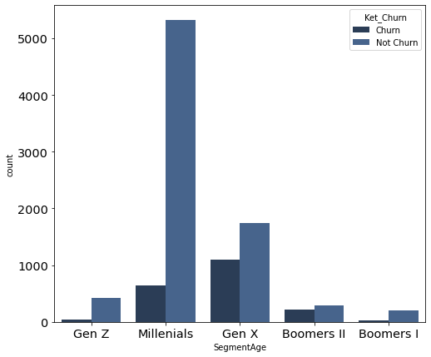





Churn Insight by Customer’s Age Category
<24 years old
-------Gen Z
24 - 40 years old
-----Millenials
The amount of customer in productive age or ‘Gen X’ category is higher than any categories.
41 - 56 years old
--------Gen X
1.038
56 - 66 years old
--Boomers II
646
40
216
97
>66 years old
---Boomers I
Although customers are dominated by Millennials, the 'Gen X' category is more potential to leave the bank services

Slide 12
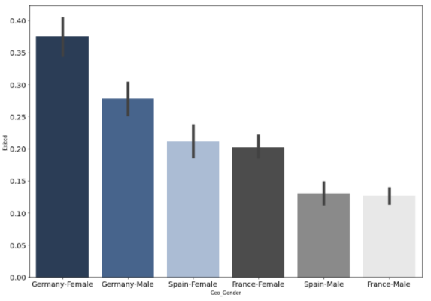
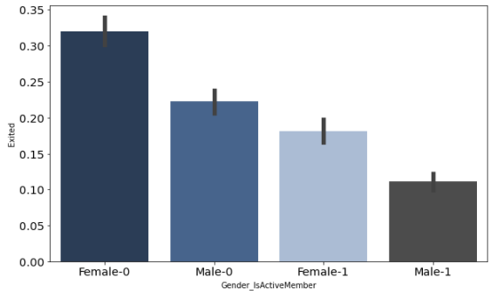
Churn by Gender, Member Status and Country
Churn by Geography and Gender
Churn by ActiveMember and Gender
18%
16%
15%
11%
9%
9%
9%
6%
7%
7%
Key Takeaways
Female customers in Germany and have status ‘Non-Active’ is more potential to Churn than any categories.
The German banking market is different from its international peer markets. Customers are likely to save money in Bank. They are more likely to leave Bank services because they are sensitive to bank interest rates.*
*Source: McKinsey and Company Report 2016 and www.wsj.com/

Slide 13
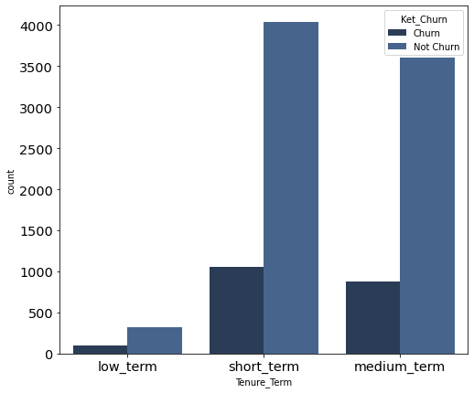
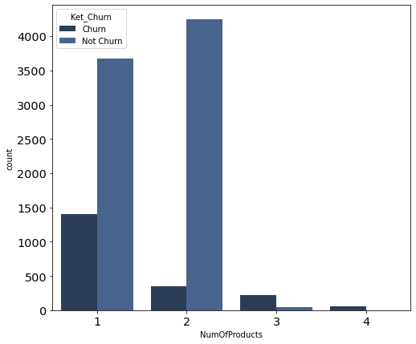
Churn Rate by Tenure and Number of Products
1403
1058
884
95
347
46
60
Key Takeaways
Customers with tenure between 1-5 years are most likely to move to another bank.
Customers owning only ‘one’ product is likely to compare Bank Joga to other Bank service, they more potential to Churn.

Slide 14
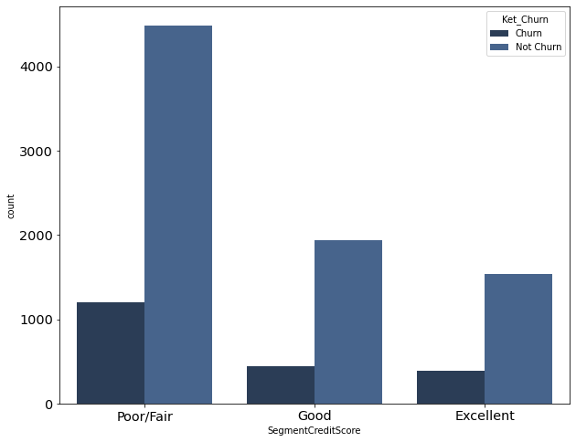
Churn Rate by Credit Score Segmentation
Churn by Credit Score Sementation
Customer segmentation based on FICO Score (Frank Kriticos Score):
740 – 850: Excellent
670 – 739: Good
350 – 669: Poor/Fair
Based on the graphic information, the customer with the 'Poor/Fair' credit score has the highest number of customers to churn.
21%
21%
18%
20%
Source: https://missionvalleynews.com/decoding-credit-scores-maximum-mortgage-savings/

Slide 15
Classification Model

Slide 16
Data Cleansing & Preprocessing
To make a better prediction, we did data cleansing and pre-processing
Missing Value,Outlier & Removing Features
There are no Null and duplicate data
Handling outlier with Z-Score
Remove CustomerId, RowNumber, Surname which is an abstract data and did not have correlation with churn
Label Encoding & One-Hot Endcoding
Geography dan Gender feature dimodifikasi dengan one-hot encoding
Others categorical feature modified using label encoding
Normalization /Standarization
Before modelling, we ensure all feature data are normalized.
SMOTE Oversampling
Balancing the train dataset for better Model learning.
Notes:
Slide 16
Untuk menemukan hasil prediksi yang baik, proses selanjutnya harus dimulai dengan melakukan data cleansing dan preprocessing. Dalam dataset ini tidak ditemukannya data null dan data duplikat pada dataset, namun terdapat outlier pada feature CreditScore. Handling outlier ini menggunakan Z-Score dan berhasil mendrop 8 row dataset. Selanjutnya Melakukan drop kolom yang dianggap tidak berhubungan dengan target karena data bersifat identitas seperti CustomerID, RowNumber,Surname.
Tahap selanjutnya, Data kategori akan dimodifikasi menjadi numerik binary yakni pada feature Geografi dan gender dengan mengunakan one-hot encoding. Selain itu label encoding juga dilakukan pada feature Balance,Age,Numofproduct,Tenure,CreditScore untuk mengali insight yang ada.
Proses Normalization juga dilakukan sebelum modelling dan pemilihan normalization ini berdasarkan sifat data skew dan terdistribusi rata.

Slide 17
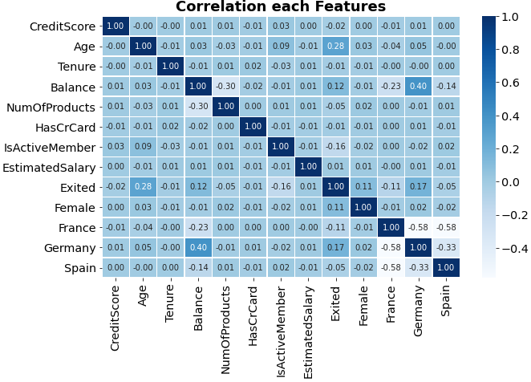
Feature Correlation
To analyze which aspect have the most significant effect to customer’s churn
Key Takeaways
Correlation use pearson Correlation.
Features which have correlation towards churn are indicated more than 0.1 or less than -0.1.
Strongest correlating features are Age , Balance, IsActiveMember, Female,Germany.
Notes:
Slide 17
Dalam Feature Correlation ini kita ingin melihat signifikansi korelasi feature terhadap target. Korelasi ini juga mengunakan pearson korelasi dan melihat nilai korelasi yang dianggap signifikan berpengaruh terhadap target yaitu >0.1 atau > - 0.1. Ternyata ditemukan beberapa feature yang memiliki korelasi signifikan yaitu Age,Balance,IsActiveMember,Female, dan Germany.

Slide 18
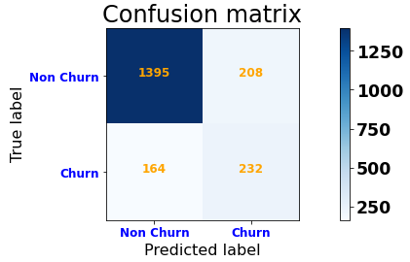
Modelling and Evaluation
Modelling with XGBoost Classifier is the best performing among other classifiers
Classifier
 | Logistic Regression | Random Forest | Decision Tree | K-nearest Neighbor | Ada Boost | XG Boost
Accuracy | 0.70 | 0.81 | 0.79 | 0.77 | 0.78 | 0.80
Precision | 0.37 | 0.51 | 0.48 | 0.47 | 0.46 | 0.51
Recall | 0.70 | 0.61 | 0.62 | 0.71 | 0.72 | 0.72
F1-Score | 0.48 | 0.56 | 0.54 | 0.57 | 0.56 | 0.60
AUC | 0.70 | 0.73 | 0.73 | 0.76 | 0.76 | 0.77
Train score | 0.71 | 0.98 | 0.98 | 0.84 | 0.79 | 0.82
Test score | 0.70 | 0.81 | 0.79 | 0.77 | 0.78 | 0.80
Eval Metrics
Recall is used to prevent incorrectly predicting customers who are going to leave bank as not leave/churn.
Notes:
Slide 18
Berdasarkan beberapa feature yang telah dipilih dan asumsi normalisasi, Tahap selanjutnya melakukan modelling dengan membandingkan 6 algoritma model klasifikasi dengan mempertimbangkan recall sebagai fokus evaluasi model untuk mengantisipasi kesalahan prediksi customer yang churn.Jika kita melihat confusion matrix terlihat jelas bahwa data True Positive dan False Positive cukup seimbang.
Akhirnya hasil XGBoost memberikan hasil recall yang lebih tinggi dengan kondisi yang tidak overfitting atau underfitting.

Slide 19
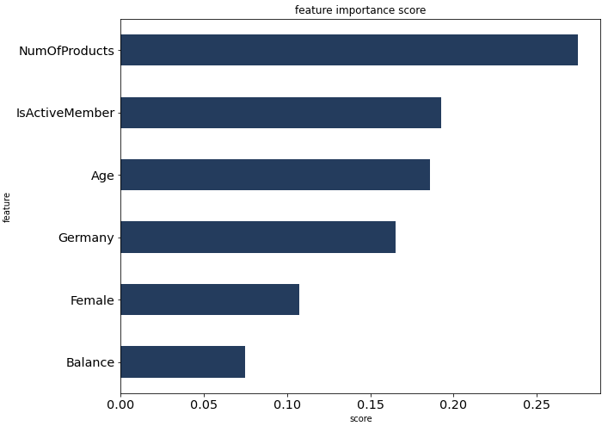
Feature Importance from Model
Key Takeaways
The number of products customer’s have are the most contributing features creating churn (>0.25)
Customer activity status and Age are also significant influence on churn
Notes:
Slide 19
Beberapa Feature important juga dapat ditemukan dari model XGBoost. Feature yang paling penting diurutkan pada Numofproduct, IsActiveMember, Age, Germany, Female, dan Balance. NumofProduct memiliki score paling tinggi dengan lebih dari 0.25 dan feature lainnya juga memberikan pengaruh yang cukup signifikan juga. Maka berdasarkan feature important ini akan dibentuk strategi bisnis untuk menarik kembali perhatian customer.

Slide 20
Business Recommendation

Slide 21





Model Conclusion for Business Strategy
Call center
Email blast
Social Media
Customer that potential to churn:
Using 1 product
Is Non-Active Member
Gen X
From Germany
Bank Joga will contact personally all Customers who have a potential churn category. The bank will offer promos and recommendations to customers to reduce the amount of churn.
Female
Gold Card
From 2,037 churned customers, the model can predict 72% customers that potential to churn (1.467 customers).

Slide 22
Business Strategy to re-engage Customer's Churn (1/2)
Customers that potential to churn:
Gen X | Gold Card | Using 1 product | Female-NonActiveMember | Germany
Cashback
Rewards
Actions:
Give 5% Cashback (max. 15$) voucher for using debit-card
Discount 10% (max. 25$) for using credit-card (beauty, grocery, food, travel)
Area Improvements:
To prevent customers from inactivity
To attract female adult customers that nominated by GoldCard category
Mechanism:
Customers will get cashback to customer accounts with a maximum cashback of 15$
Customers will get 10% discount up to $25 with credit card payment
Funding
Promo
Area Improvements:
To attract customers that nominated by in mature age and have settle income.
To attract customers to increase the number of product
Mechanism:
The customer will pay half the price of 1st Month Endowment Insurance as one of Bank Joga's products.
Customers will get a higher of deposit interest rate for the 3 months
Actions:
Discount 50% (max.50$) for the 1st month Endowment Life Insurance Payment
Deposit Special Rate (6%) for 3 months

Slide 23
Business Strategy to re-engage Customer's Curn (2/2)
Description:
Projection Approach:
Cost:
5% cashback voucher
#Max Cashback $15
#Max Discount
25$
#Max Discount
50$
#Min. Deposit 25.000 $
# In-Active customer
(target : 100)
# Female-Gold Card Customer
(target : 250)
# Gen-X customers from Germany
(target : 150)
#Use 1 product Customer
(target : 250)
# Max Transaction (3)
# Max Transaction (2)
# Max Transaction (1)
#Special rate for 3 months of deposit period
$ 1.500
10% discount of payment
$ 6.250
50% Discount for the 1st month endowment life insurance
$ 10.000
Special rate deposit (rate 6% per annum)
$ 72.000
The total amount of Bank fees to cover customer churn treatment is approximately $ 89.750 and Bank Joga will get Break Even Point (BEP) in the 9th month with promo duration 1 year.
Bank will get amount of balance $ 66.180.000 (from min.balance each prediction customer per month is $100)

Slide 24
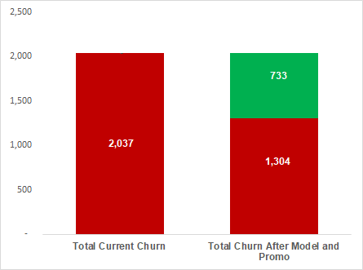
Reduce the Number of Churn Customers
Churned Customers
Key Takeaways
Reduce 36%
churned customers
Projection for Customers churn after re-engagement is implemented, 64% churn will be reduced from ~2.037 customers to 1.304.
Bank Joga can predict 72% from all churned customers (1.467) and with business strategy can save 50% churn customers prediction (733).
Since re-engagement is targeting to Gold-Card holders, Bank Joga can maintain 733 customers to stay in Bank services.

Slide 25
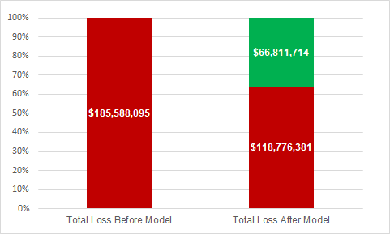
Reduce Bank Loss of Customer Churn
35%
Saving money
Key Takeaways
After the strategy is applied to all customers, Bank Joga can reduce Current Loss by
$ 118.776.381 from $ 185.588.095.
Bank Joga can save 35% of all total losses from churn customers from modeling predictions. Bank Joga can reduce losses is around $ 66,811,714.

Slide 26
Thank You

Slide 27
Lampiran

Slide 28
Lampiran Pemodelan
Logistic Regression
Key Takeaways
Evaluation Metrics
Logistic Regression ini digunakan sebagai base model awal, guna melihat evaluasi dari model yang ada.
Beberapa feature yang digunakan dalam model adalah NumOfProduct,Age,Germany,Female, Balance,IsActiveMember.
Seluruh feature telah di Normalization, berdasarkan data terlihat skew.
Berdasarkan score, Model ini tidak mencerminkan overfitting atau underfitting.
Accuracy (Test Set): 0.71
Precision (Test Set): 0.37
Recall (Test Set): 0.69
F1-Score (Test Set): 0.48
AUC: 0.70
Train/Test Score
Train score: 0.7130503144654088
Test score:0.7003551775887944

Slide 29
Lampiran Pemodelan
Key Takeaways
Decision Tree
Decision Tree
Tuning Parameter
Hasil train/test score menunjukkan adanya overfitting pada model.
Nilai Recall setelah di tunning lebih kecil 0.01 dari yang sebelumnya atau tunning tidak memberikan dampak yang signifikan.
Nilai recall Decision Tree lebih rendah dibandingkan dengan Logistic Regression.
Evaluation Metrics
Evaluation Metrics
Accuracy (Test Set): 0.78
Precision (Test Set): 0.46
Recall (Test Set): 0.60
F1-Score (Test Set): 0.52
AUC: 0.71
Accuracy (Test Set): 0.79
Precision (Test Set): 0.48
Recall (Test Set): 0.59
F1-Score (Test Set): 0.53
AUC: 0.72
Train/Test Score
Train/Test Score
Train score: 0.9811320754716981
Test score:0.7893946973486743
Train score: 0.900377358490566
Test score:0.5957575757575758

Slide 30
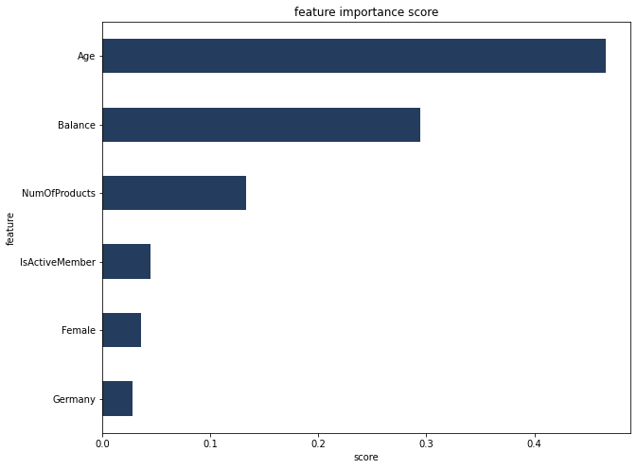
Lampiran Pemodelan
Decision Tree
Features Important
Key Takeaways
Age menjadi feature yang sangat berpengaruh dalam model DecisionTree
Balance dan NumOfProducts juga merupakan faktor penting harus dipertimbangkan.
IsActiveMember, Female dan Germany sedikit berpengaruh dalam perhitungan model.

Slide 31
Lampiran Pemodelan
KNeighborsClassifier
KNeighborsClassifierTuning Parameter
Key Takeaways
Nilai Recall setelah ditunning mengalami penurunan nilai 0.13 dari sebelumnya.
Perbedaaan Train/Test score setelah ditunning sangat signifikan (overfitting).
Evaluation Metrics
Evaluation Metrics
Accuracy (Test Set): 0.77
Precision (Test Set): 0.45
Recall (Test Set): 0.70
F1-Score (Test Set): 0.55
AUC: 0.75
Accuracy (Test Set): 0.81
Precision (Test Set): 0.53
Recall (Test Set): 0.60
F1-Score (Test Set): 0.56
AUC: 0.73
Train/Test Score
Train/Test Score
Train score: 0.8338050314465408
Test score:0.7748874437218609
Train score: 0.9077232286643
Test score:0.52242152636771

Slide 32
Lampiran Pemodelan
RandomForest
RandomForest
Tuning Parameter
Key Takeaways
Nilai Recall setelah ditunning mengalami peningkatan nilai 0.02 dari sebelumnya.
Perbedaaan Train/Test score setelah ditunning sangat signifikan (overfitting).
Evaluation Metrics
Evaluation Metrics
Accuracy (Test Set): 0.81
Precision (Test Set): 0.53
Recall (Test Set): 0.60
F1-Score (Test Set): 0.56
AUC: 0.73
Accuracy (Test Set): 0.82
Precision (Test Set): 0.54
Recall (Test Set): 0.62
F1-Score (Test Set): 0.58
AUC: 0.74
Train/Test Score
Train/Test Score
Train score: 0.9811320754716981
Test score:0.8139069534767384
Train score: 0.9402956459416
Test score:0.8736523929471

Slide 33
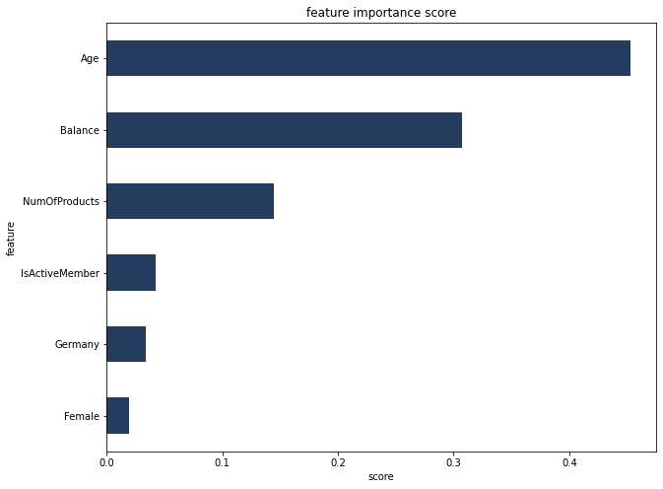
Lampiran Pemodelan
RandomForest
Features Important
Key Takeaways
Age menjadi feature yang sangat berpengaruh dalam model RandomForest ini.
Balance dan NumOfProducts juga merupakan faktor penting harus dipertimbangkan.
IsActiveMember, Female dan Germany sedikit berpengaruh dalam perhitungan model.

Slide 34
Lampiran Pemodelan
Adaboost
Adaboost
Tuning Parameter
Key Takeaways
Nilai Recall setelah ditunning tidak mengalami perubahan yang signifikan dan lebih baik hasilnya sebelum ditunning.
Perbedaaan Train/Test score setelah ditunning masih menunjukkan data yang fit.
Evaluation Metrics
Evaluation Metrics
Accuracy (Test Set): 0.78
Precision (Test Set): 0.46
Recall (Test Set): 0.73
F1-Score (Test Set): 0.57
AUC: 0.76
Accuracy (Test Set): 0.77
Precision (Test Set): 0.45
Recall (Test Set): 0.71
F1-Score (Test Set): 0.55
AUC: 0.75
Train/Test Score
Train/Test Score
Train score: 0.7872641509433962
Test score:0.7798899449724862
Train score: 0.7679243018868
Test score:0.70707070707071

Slide 35
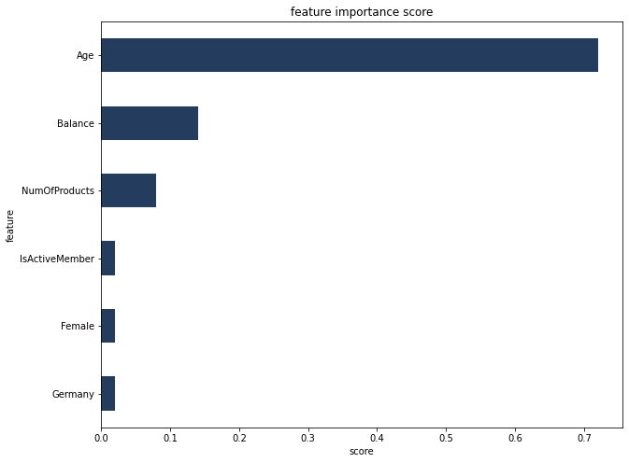
Lampiran Pemodelan
Adaboost
Features Important
Key Takeaways
Age menjadi feature yang sangat berpengaruh dalam model Adaboost ini.
Balance dan NumOfProducts juga merupakan faktor penting berikutnya yang harus dipertimbangkan.
IsActiveMember, Female dan Germany sedikit berpengaruh dalam perhitungan model.

Slide 36
Lampiran Pemodelan
XGboost
XGboost
Tuning Parameter
Key Takeaways
Evaluation Metrics
Evaluation Metrics
Nilai Recall setelah ditunning tidak mengalami perubahan yang signifikan dan lebih baik hasilnya sebelum ditunning.
Perbedaaan Train/Test score setelah ditunning masih menunjukkan data yang fit.
Accuracy (Test Set): 0.80
Precision (Test Set): 0.51
Recall (Test Set): 0.72
F1-Score (Test Set): 0.60
AUC: 0.77
Accuracy (Test Set): 0.81
Precision (Test Set): 0.52
Recall (Test Set): 0.59
F1-Score (Test Set): 0.55
AUC: 0.73
Train/Test Score
Train/Test Score
Train score: 0.8194182389937107
Test score:0.8019009504752376
Train score: 0.945440251572327
Test score:0.5909090909090909

Slide 37
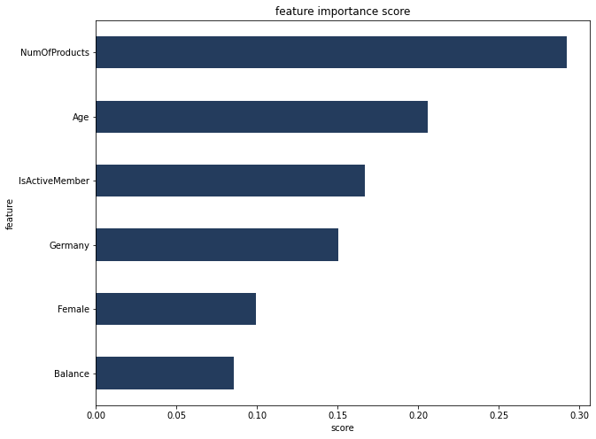
Lampiran Pemodelan
XGboost
Features Important
Key Takeaways
NumOfProducts menjadi feature yang sangat berpengaruh dalam model Adaboost ini.
Age dan IsActiveMember juga merupakan faktor penting berikutnya yang harus dipertimbangkan.
Germany,Female dan Balance sedikit berpengaruh dalam perhitungan model.

Slide 38
Modelling and Evaluation
Modelling with XGBoost Classifier is the best performing among other classifiers
Classifier
 | Logistic Regression | Random Forest | Decision Tree | K-nearest Neighbor | Ada Boost | XG Boost
Accuracy | 0.71 | 0.81 | 0.79 | 0.77 | 0.78 | 0.81
Precision | 0.37 | 0.51 | 0.48 | 0.45 | 0.46 | 0.51
Recall | 0.69 | 0.59 | 0.62 | 0.70 | 0.72 | 0.72
F1-Score | 0.48 | 0.55 | 0.54 | 0.55 | 0.56 | 0.60
AUC | 0.70 | 0.73 | 0.73 | 0.75 | 0.76 | 0.78
Train score | 0.71 | 0.98 | 0.98 | 0.83 | 0.78 | 0.81
Test score | 0.70 | 0.81 | 0.79 | 0.77 | 0.77 | 0.80
Eval Metrics
Recall is used to prevent incorrectly predicting customers who are going to leave bank as not leave/churn.

